Slide 1
Recent Advances in Dialogue and Text Generation at ADAPT-Lab
Kenny Zhu
06/23/2020

Slide 2
Contents
1
Overview of SJTU-ADAPT
2
Dialogue Response Selection
3
Clarification Question Generation
4
Abstractive Summarization

Slide 3
SJTU-ADAPT
NLP and Knowledge Engineering
Commonsense reasoning
Text generation
AAAI/IJCAI/ACL/EMNLP
Team consists of
1 professor
5 PhD students
12 MSc students
N undergrads + interns

Slide 4
Multi-turn Dialogue Response Selection

Slide 5
Contents
1
Task Description
2
Motivation
3
Approach
4
Evaluation

Slide 6
Task Description
Multi-turn response selection
A: how long does a package wait in the proposed queue til it makes - proposed ?
B: no real time span the work is done by individual teams at times so you would have to watch for it basically .
A: thanks
B: some like say a new ff update from mozilla might move fast , but not be ported to a earlier release .
A: i 'm confused by this comment
B: ???
Context
looks like it says fixed in quantal the development release to be released on oct 28 hehe with a different name as well .
http://pastebin.com/pydcqbqi ah , then modify the command to : cairo-dock obviously delete the current startup item
i believe that 's where it depends how much the reader wants to learn
Candidates

Slide 7
Contents
1
Task Description
2
Motivation
3
Approach
4
Evaluation

Slide 8
Previous Work
Sequential Models
Hierarchical Models
Pre-trained Language Models

Slide 9
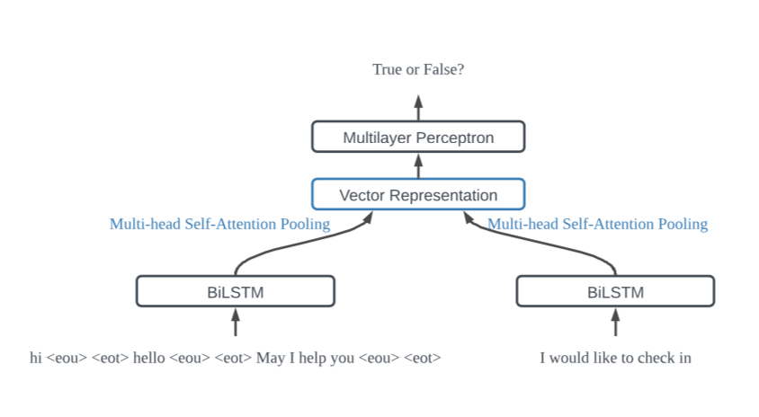
Sequential Models
Concatenate the history utterances into a long sequence
Try to capture the similarities between this sequence and the response
Give a matching score.

Slide 10
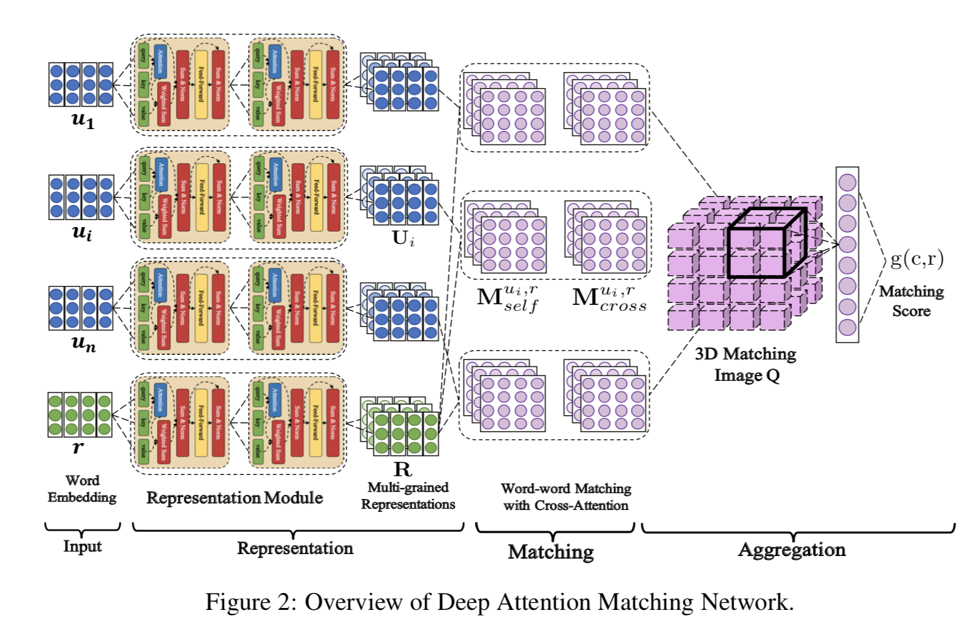
Hierarchical Models
Extract similarities between each history utterance and the response
The matching information aggregated from each pair (mostly in a chronological way)

Slide 11
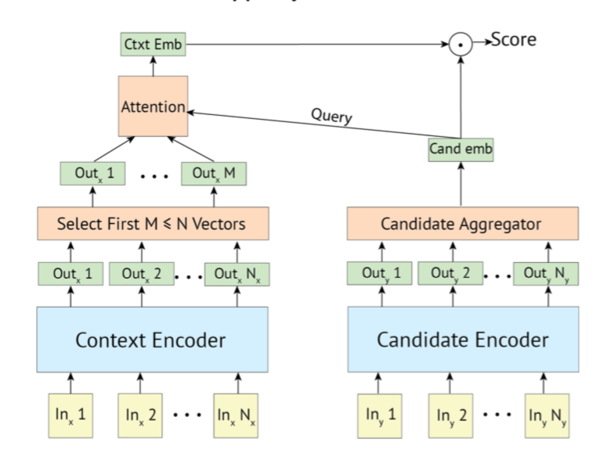
Pretrained Language Models
concatenating all of the utterances as the input.

Slide 12
Motivation
concatenating all of the utterances as the input
The dialogue dependency information between the utterances is largely ignored due to the concatenation operation.
Both in two-party and multi-party dialogues, several dialogue threads may entangle with each other.
Each dialogue thread is a self-contained sub-dialogue.

Slide 13
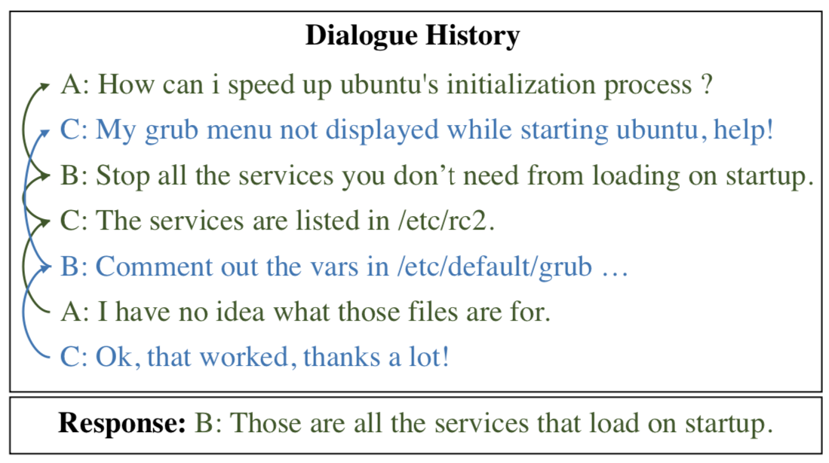
Motivation -- multi-party

Slide 14
Motivation -- two-party

Slide 15
Contents
1
Task Description
2
Motivation
3
Approach
4
Evaluation

Slide 16
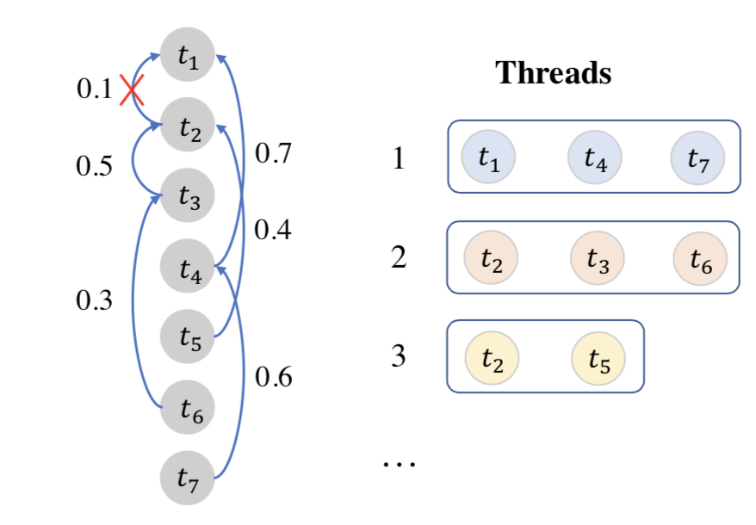
Approach
Dialogue Extraction Algorithm
1. Do discourse parsing for dialogue context.
2. Extract original context into the dialogue threads according to parsed tree
Notes:
可加图举例

Slide 17
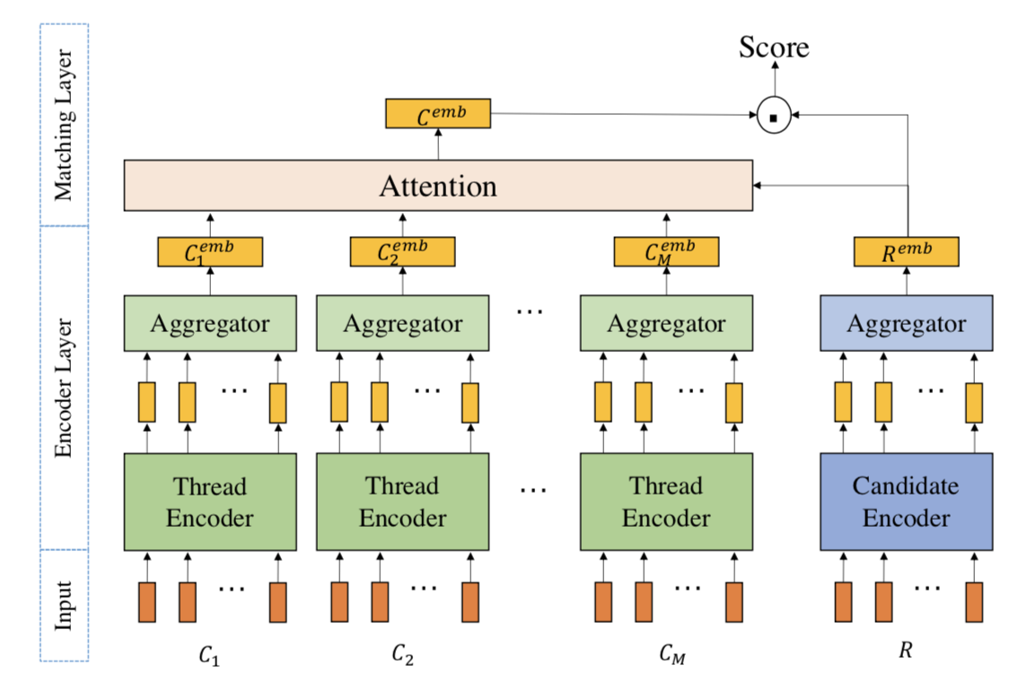
Approach
Thread-based Encoder Model

Slide 18
Contents
1
Task Description
2
Motivation
3
Approach
4
Evaluation

Slide 19
Evaluation
Extraction Results
how long does a package wait in the proposed queue til it makes - proposed ?
no real time span the work is done by individual teams at times so you would have to watch for it basically .
thanks
some like say a new ff update from mozilla might move fast , but not be ported to a earlier release .
i 'm confused by this comment

Slide 20
Evaluation
Previous Input
Noise
how long does a package wait in the proposed queue til it makes - proposed ? [SEP] no real time span the work is done by individual teams at times so you would have to watch for it basically . [SEP] thanks [SEP] some like say a new ff update from mozilla might move fast , but not be ported to a earlier release . [SEP] i 'm confused by this comment
looks like it says fixed in quantal the development release to be released on oct 28 hehe with a different name as well .

Slide 21
Evaluation
Our Method
how long does a package wait in the proposed queue til it makes - proposed ? [SEP] no real time span the work is done by individual teams at times so you would have to watch for it basically . [SEP] thanks
Thread-1
looks like it says fixed in quantal the development release to be released on oct 28 hehe with a different name as well .
how long does a package wait in the proposed queue til it makes - proposed ? [SEP] some like say a new ff update from mozilla might move fast , but not be ported to a earlier release . [SEP] i 'm confused by this comment
Thread-2

Slide 22
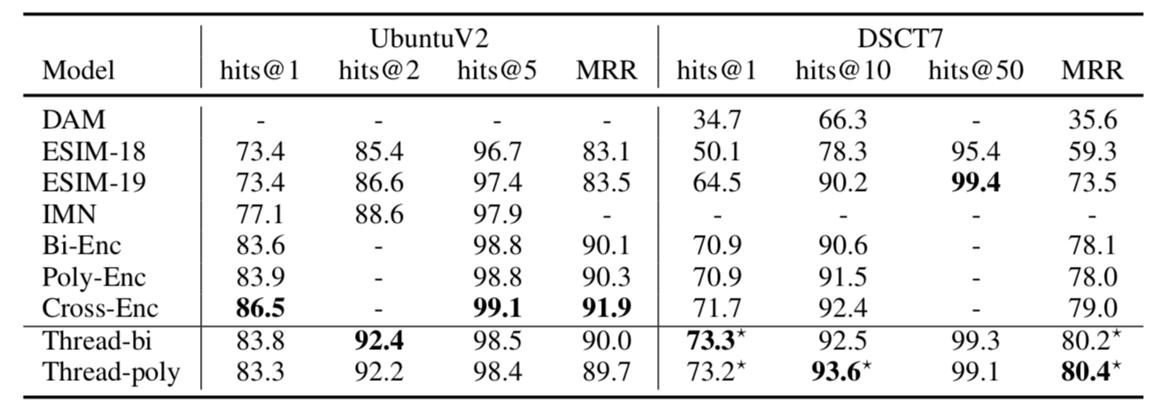
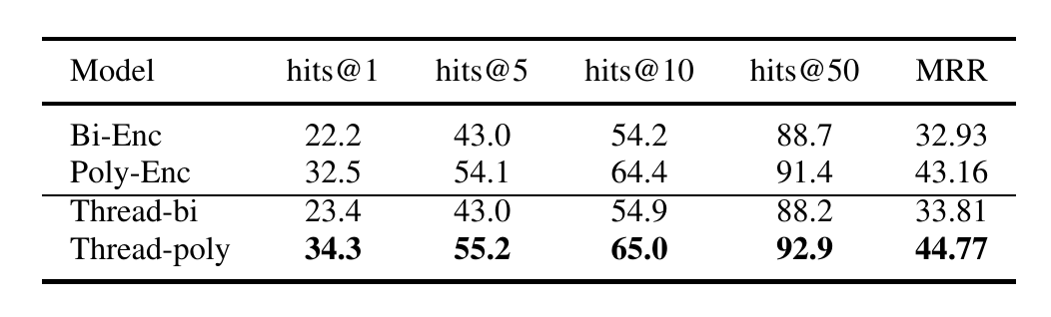
Evaluation
Response selection results
DSCT8

Slide 23
Clarification Question Generation

Slide 24
Contents
1
Introduction
2
Approach
3
Results
4
Related Works
5
Conclusion

Slide 25
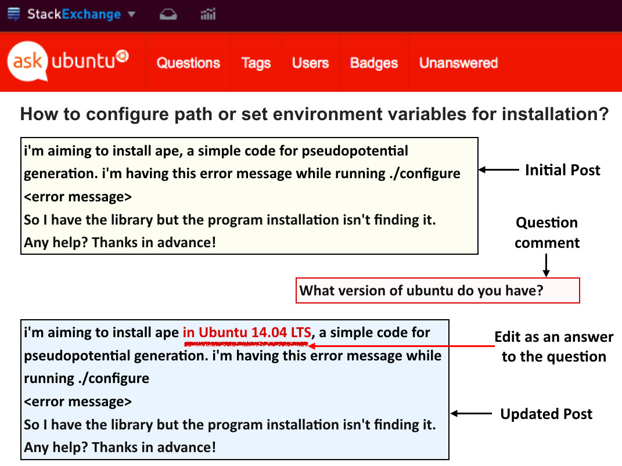
Motivation - StackExchange
The original post is too underspecified
Helper asks questions to clarify the necessary details missing from the context
Notes:
REF: Learning to Ask Good Questions: Ranking Clarification Questions using Neural Expected Value of Perfect Information

Slide 26
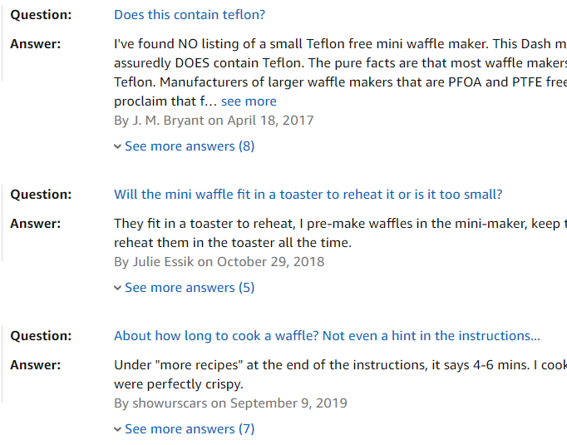
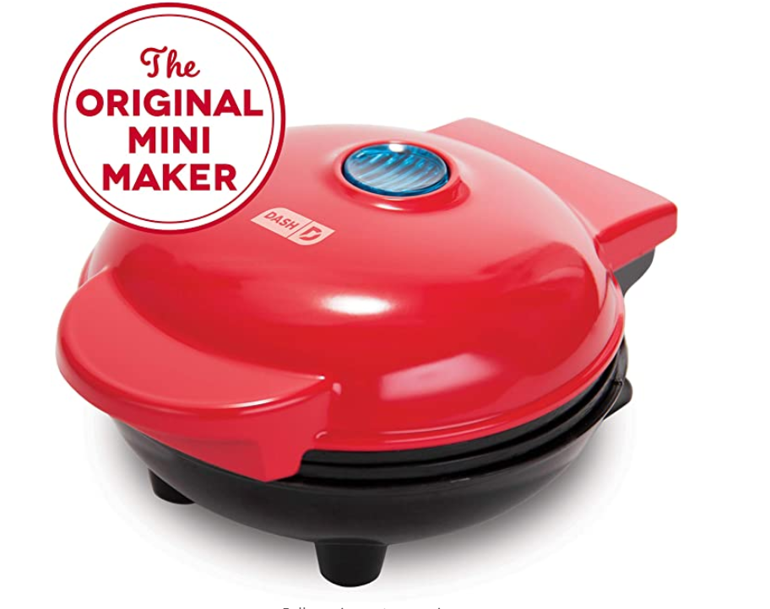
Motivation - Amazon
The original product description misses info that the customer cares about
Customer asks questions for them to decide whether to purchase
Notes:
https://www.amazon.com/Dash-Mini-Maker-Individual-Breakfast/dp/B010TCP3SC?pf_rd_r=Z9PEZ1MR6VNW9JFN4TGZ&pf_rd_p=000fa563-9003-47fd-b569-486d528b7413&pd_rd_r=d30728b6-1f78-414e-9338-f02726ffcfdc&pd_rd_w=RVF8j&pd_rd_wg=mMHPA&ref_=pd_gw_unk&th=1

Slide 27
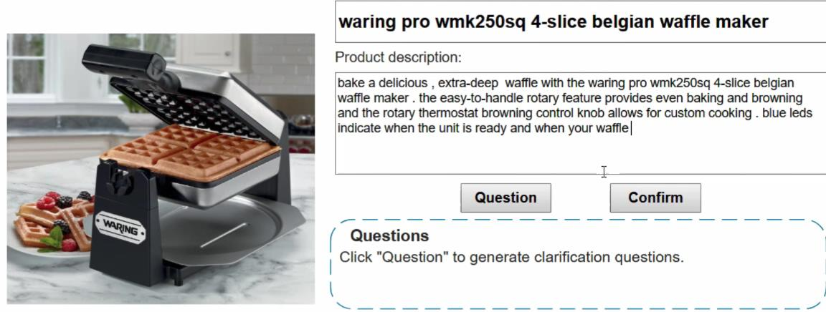

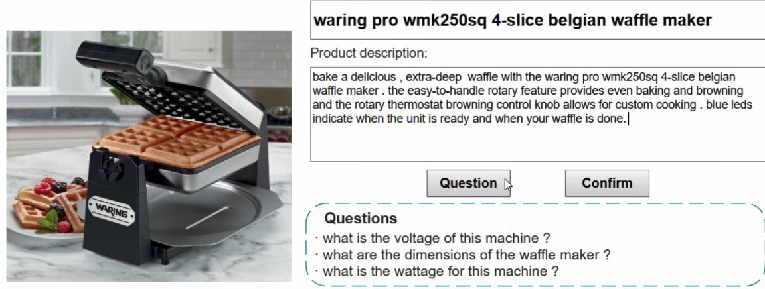
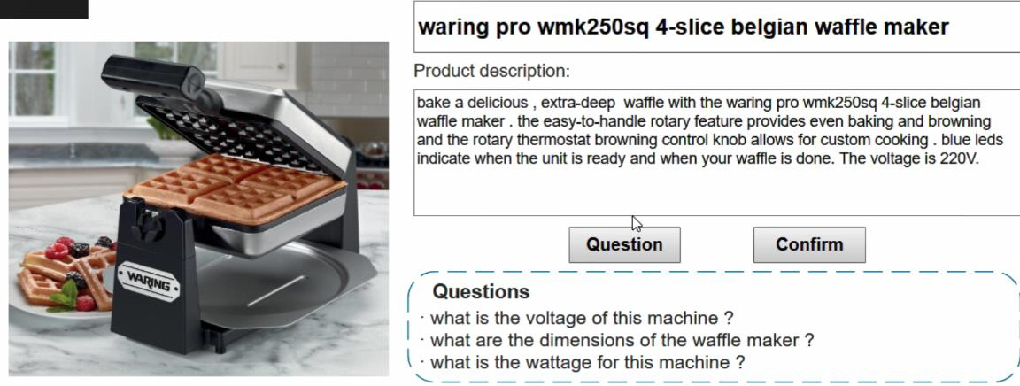
The proposed writing assistant
Notes:
1-2. Write the initial description
2-3. ask for CQs
3-4. Fill in missing information according to the generated questions.

Slide 28
Challenge
Basic requirement: CQ asks for information missing from the context
The question should be specific to be useful
Specific to electrical appliance: What is the voltage?
Generic question: What are the dimensions?
We need diverse questions to cover a wide range of user needs
Diverse group:
What is the voltage? Does it contain taflon? How long does it take to cook waffle?
Repetitive group:
What are the dimensions? What’s the size? What is the height?

Slide 29
Contents
1
Introduction
2
Approach
3
Results
4
Related Works
5
Conclusion

Slide 30
Finding
Keywords: non-stopping v./n./adj. words
The main content of a question can be covered by keywords
What are the voltage ?
can you chop nuts and blend items together ?
Is it microwave safe?
We may control the generation with generation conditioned on keywords
generate specific questions with specific keywords
Generate diverse questions with different groups of keywords

Slide 31
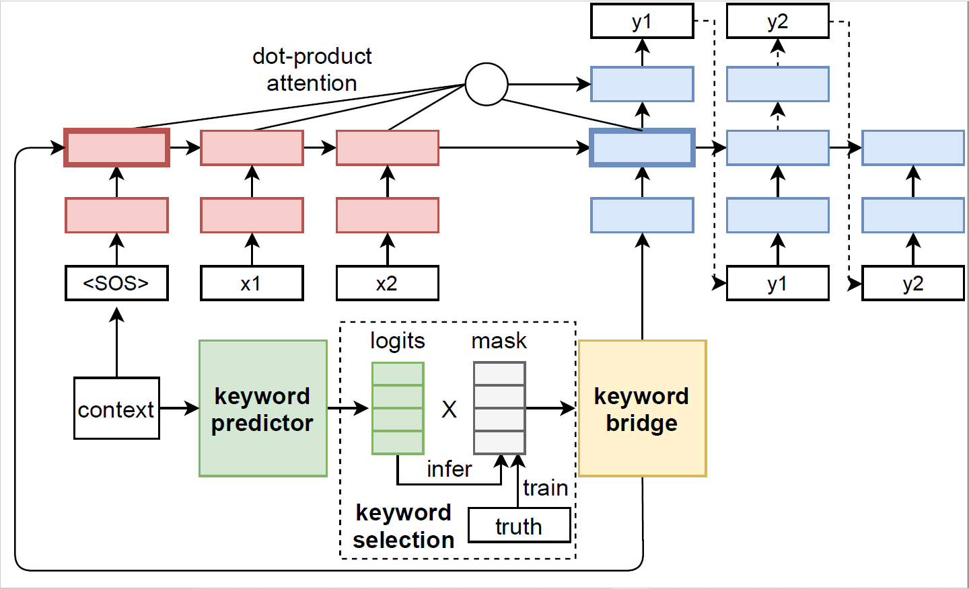
Approach: KPCNet
Notes:
其中下面一些把关键词信息融入生成的模块是我的主要创新点

Slide 32
Keyword predictor
Input: context
Target: for each word in a pre-extracted keyword set, decide if it is keyword of the question (multi-label binary classification)
Model: TextCNN
Output: Keyword logits: unnormalized(sigmoid) probability

Slide 33
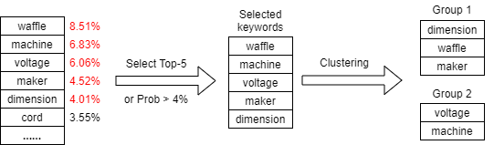
Keyword selection
First get a distribution over all keywords from keyword predictor
Select most likely keywords with Top-K, or threshold
May be incoherent in semantic if put together
Keyword Clustering
Ensure coherence with semantic information
Spectral clustering on word co-occurrence graph
Produce different conditioning group for diverse generation
Notes:
直接使用最高的那几个词语可能有问题，就是它们可能是分散在几个问题里的，硬性放在一起会出现语义的不通顺。所以我们可以使用聚类方法，首先是保证语义通顺的关键词被聚在一组。同时这种方法也产出了不同的关键词组，可以用来生成多样化的问题。
选取的keywords会转化为binary mask，通过乘法过滤掉其他无关关键词信息，从而实现控制。

Slide 34
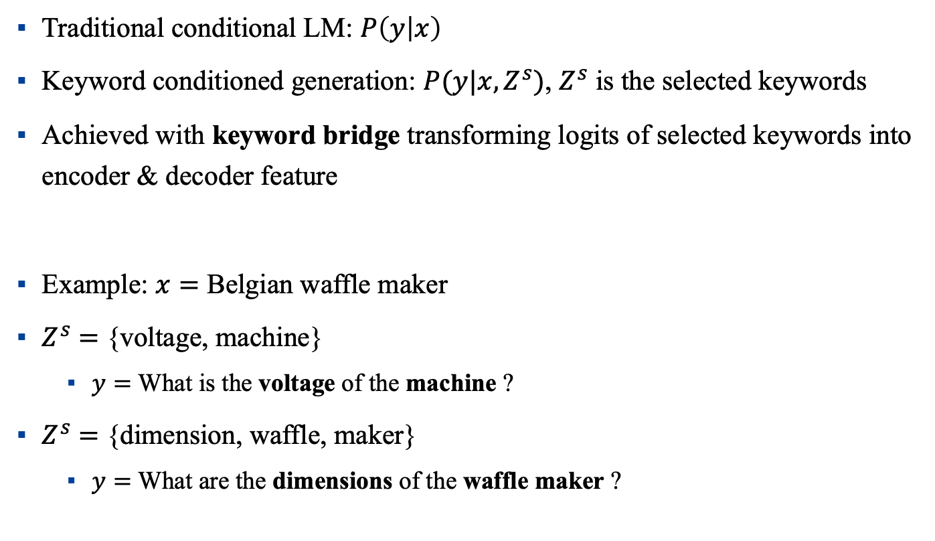
Keyword conditioned generation
Traditional conditional LM: $P\left(y | x\right)$
Keyword conditioned generation: $P(y|x,Z^{s})$, $Z^{s}$ is the selected keywords
Achieved with keyword bridge transforming logits of selected keywords into encoder & decoder feature
Example: $x=$ Belgian waffle maker
$Z^{s}$ $=$ {voltage, machine}
$y=$ What is the voltage of the machine ?
$Z^{s}$ $=$ {dimension, waffle, maker}
$y=$ What are the dimensions of the waffle maker ?
Notes:
加入这个条件的方法是通过keyword bridge blabla
从下面的例子中可以看到对相同的上下文，基于不同的关键词会生成不同的问题

Slide 35
Contents
1
Introduction
2
Approach
3
Results
4
Related Works
5
Conclusion

Slide 36
Compared systems
MLE: vanilla seq2seq model trained with MLE objective
Diversity from beam search
hMup: one representative of Mixture of Experts model for diverse machine translation, and can be adapted to CQGen
Diversity from the model’s mixture distribution
KPCNet(cluster): best KPCNet variant
keyword selection with Spectral Clustering on Top-K keywords
Notes:
Only focus on the best variant KPCNet(cluster)

Slide 37
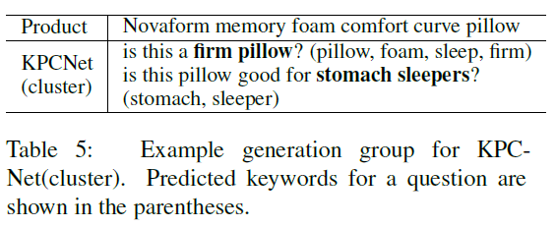
KPCNet(cluster) Analysis
For each sentence, the conditioned keywords will partially show up in the generation
For the group, diverse generation are promoted with different conditioning keyword set
The keyword set produced by clustering are specific and coherent, leading to good generation quality
Notes:
Specifically explain KPCNet(cluster) first

Slide 38
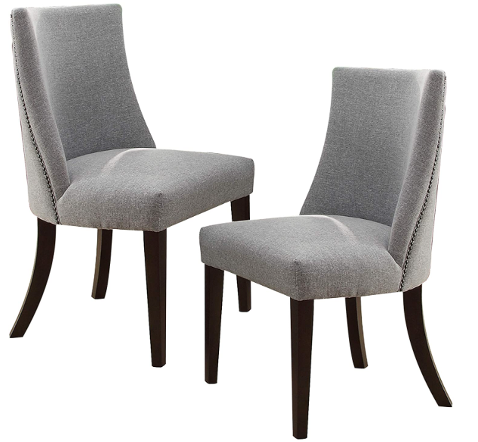
Comparison
Product: homelegance 2588s accent dining chair , blue grey , set of 2
MLE (1 useful question, all equivalent, and not specific)
what is the seat height ?
what are the dimensions of the chair ?
what are the dimensions ?
hMup (1 useful question, diverse but problematic)
what is the weight limit for the chair ?
i have a table that is a UNK. will this chair be able to fit on a table ? [strange]
is this a set of 2 chairs or just one ? [repetitive]
KPCNet (2 useful questions, diverse and cover specific aspects)
what is the color of the chair ? [repetitive]
what are the dimensions of the seat ?
what is the weight limit?

Slide 39
Analysis
MLE
Tend to generate universal questions for higher likelihood
Likely to overlap with each other for beam search
hMup
Can generate diverse questions from the its mixture distribution
The latent variable for mixture is not explicitly supervised, thus hard to interpret and control, and may produce strange output sometimes
KPCNet
Specific aspects covered by keywords
Diversity comes from different conditioning keyword sets (controllability)
Sample keywords from keyword predictor for relevance
Clustering keywords for coherence
Notes:
Also keyword filtering to avoid repetition. But not mentioned before, so omit here.

Slide 40
Contents
1
Introduction
2
Approach
3
Results
4
Related Works
5
Conclusion

Slide 41
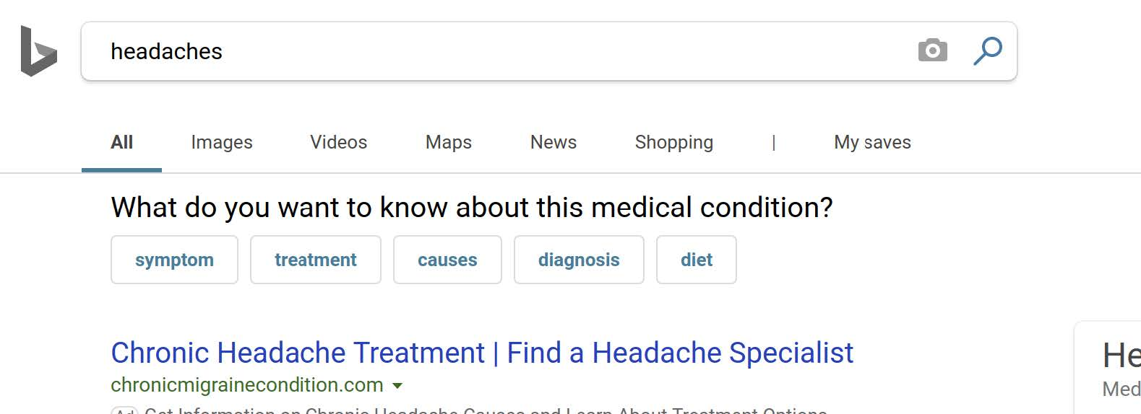
CQ for Information Retrieval
Zamani H, Dumais S, Craswell N, et al. Generating Clarifying Questions for Information Retrieval[C]//Proceedings of The Web Conference 2020. 2020: 418-428.

Slide 42
CQ for dialogue system
Wang Y, Liu C, Huang M, et al. Learning to ask questions in open-domain conversational systems with typed decoders[J]. arXiv preprint arXiv:1805.04843, 2018.

Slide 43
Contents
1
Introduction
2
Approach
3
Results
4
Related Works
5
Conclusion

Slide 44
Conclusions
We design a writing assistant to apply CQs in e-commerce description writing practice
We propose KPCNet, along with clustering-based keyword selection method to produce specific and diverse CQs
Great potential may be discovered by leveraging external knowledge to improve keyword prediction

Slide 45
Neural Abstractive Summarization by Extractor-Abstractor Framework

Slide 46
Contents
1
Task Description
2
Motivation
3
Approach
4
Evaluation

Slide 47
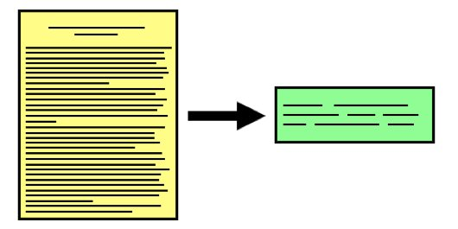
Task Description
Abstractive Summarization
Goal: produce an abridged version of a text that contains information that is important or relevant to a user.
Applications:
Newsletters → Headline on mobile devices
Earning reports and financial news → Digest for executives
Notes:
a.

Slide 48
Contents
1
Task Description
2
Motivation
3
Approach
4
Evaluation

Slide 49
Motivation
Enhance the alignment between source document and summary
First select the salient content of source document
Paraphrase the selected content to generate a summary
Keywords can help select salient content

Slide 50
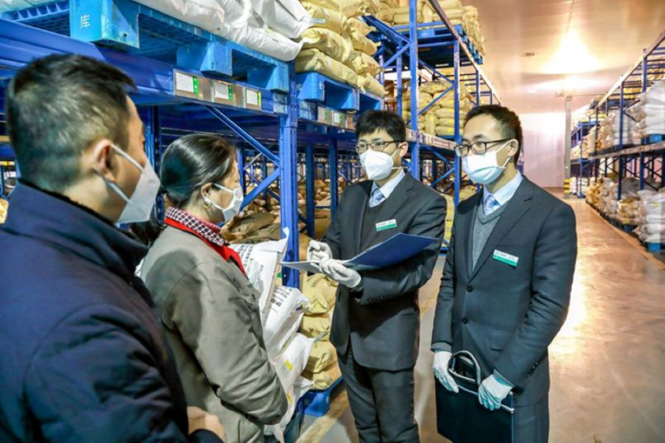
Abstractive Summarization — finance news from China Daily
Document:
BEIJING -- China's banking on Thursday pledged continued efforts to help micro, small and medium-sized enterprises (SMEs) overcome coronavirus-related challenges and take the country's reform and opening-up in the financial sector to a deeper level.
A spokesperson for the Insurance Regulatory Commission said the banking and commission will fully implement policies such as allowing SMEs to delay the repayment of capital and interest. It will also guide major banks in meeting the target of achieving growth in their lending to SMEs of more than 40 percent. The banking and insurance industry will increase funding support for new infrastructure, new urbanization initiatives and major projects, and step up efforts in financial poverty alleviation, he told reporters ……
Summary:
China's banking and insurance regulator vows to support SMEs
Notes:
a.

Slide 51
Motivation – select salient sentences
Salient sentence set — Keywords (bold)
China's banking on Thursday pledged continued efforts to help micro, small and medium-sized enterprises (SMEs) overcome coronavirus-related challenges and take the country's reform and opening-up in the financial sector to a deeper level.
A spokesperson for the Insurance Regulatory Commission said the banking and commission will fully implement policies such as allowing SMEs to delay the repayment of capital and interest.

Slide 52
Motivation – Paraphrase the selected content
China's banking on Thursday pledged continued efforts to help micro, small and medium-sized enterprises (SMEs) overcome coronavirus-related challenges and take the country's reform and opening-up in the financial sector to a deeper level.
A spokesperson for the Insurance Regulatory Commission said the banking and commission will fully implement policies such as allowing SMEs to delay the repayment of capital and interest.
Salient sentence set
Summary
China's banking and insurance regulator vows to support SMEs

Slide 53
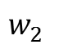
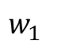
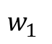
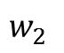
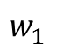
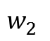
Extractor-Abstractor Model
In parallel
Extractor
Sent₁
Abstractor
$$w_{1}^{}$$
$$w_{2}^{}$$
…
EOS
Document
Sent₂
Abstractor
$$w_{1}^{}$$
$$w_{2}^{}$$
…
EOS
…
…
Sent_{n}
Abstractor
$$w_{1}^{}$$
$$w_{2}^{}$$
…
EOS
Create Pseudo Summary for training

Slide 54
Contents
1
Task Description
2
Motivation
3
Approach
4
Evaluation

Slide 55
Approach– Create set-level pseudo summaries
1. Keywords overlap
2. Most similar to
d₁
d₂
s₁
d₃
s₂
…
d_{i}
s₃
…
d_{n}
Ground-truth Summary Sentences
Selected Document Sentences

Slide 56
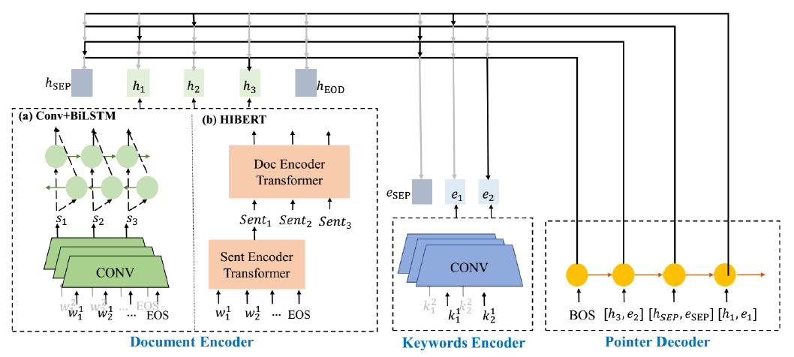
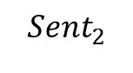
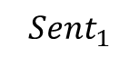

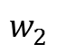
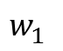
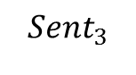
Approach– Keyword-based extractor
Document Encoder
$${Sent}_{1}$$
$${Sent}_{2}$$
$${Sent}_{3}$$
Sentence Encoder
$$w_{1}^{}$$
$$w_{2}^{}$$
$$…$$
Use a special placeholder <SEP>
to separate sentence sets
EOS
Document Encoder

Slide 57
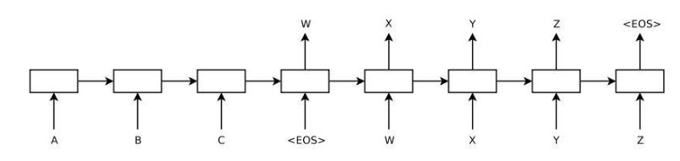
Approach– abstractor
Sequence-to-sequence model
Fine-tuning on pretrained model (BART)

Slide 58
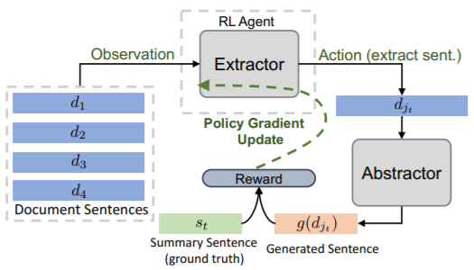
Approach: Extractor-Abstractor Model
Connect Extractor and Abstractor together
Make Extractor-Abstractor Framework an end-to-end trainable model.

Slide 59
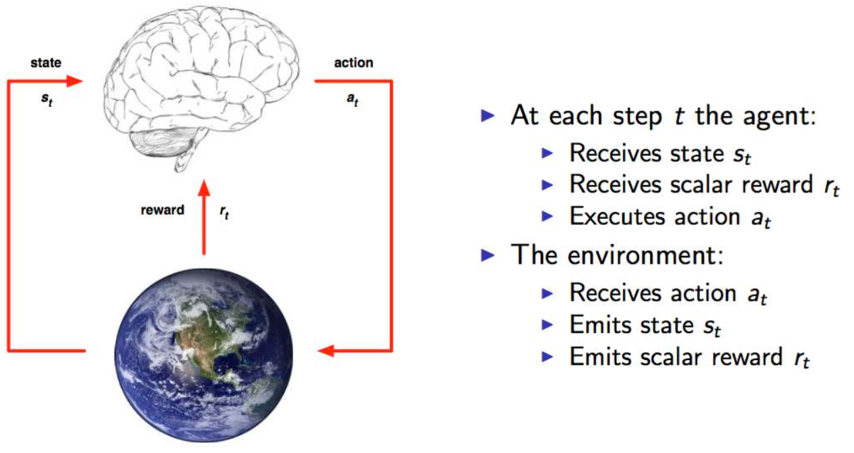
Reinforcement Learning: End-to-end

Slide 60
Contents
1
Task Description
2
Motivation
3
Approach
4
Evaluation

Slide 61
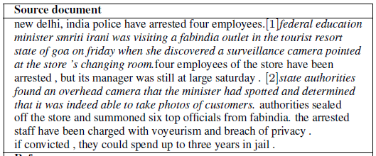
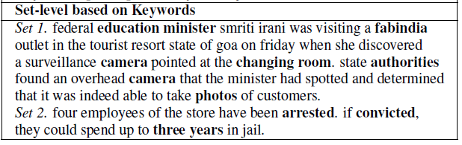
Evaluation
Extractive summary

Slide 62
Evaluation
Abstractive summary
Set 1. federal education minister smriti irani was visiting a fabindia
store the tourist resort state of goa. she saw a camera at the
changing room. authoroities discovered found it was able to take photos.
photos rom the store ’s changing room.
Set 2. the four employees could spend three years in jail if convicted.

Slide 63
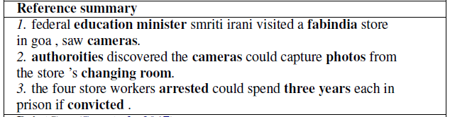
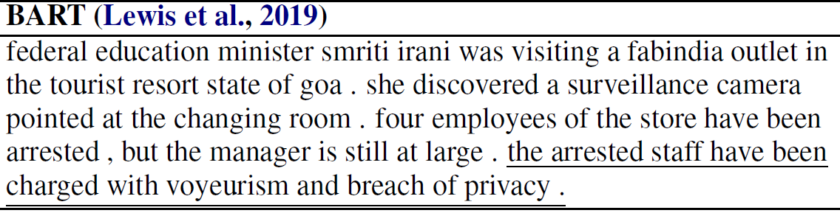
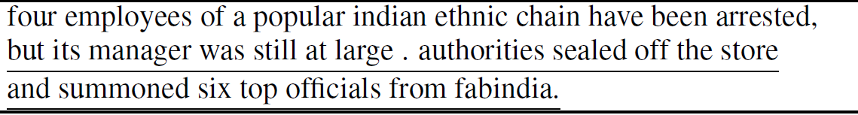
Evaluation
Lose salient information: “camera” and “three years”
Contain redundancy
(underline)
Our Generated Summary:
Set 1. federal education minister smriti irani was visiting a fabindia
store the tourist resort state of goa. she saw a camera at the changing room. authoroities discovered found it was able to take photos.
photos rom the store ’s changing room.
Set 2. the four employees could spend three years in jail if convicted.

Slide 64
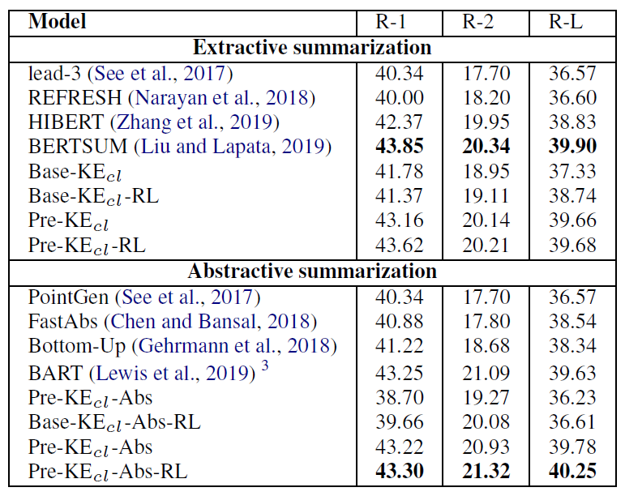
Evaluation
ROUGE score

Slide 65
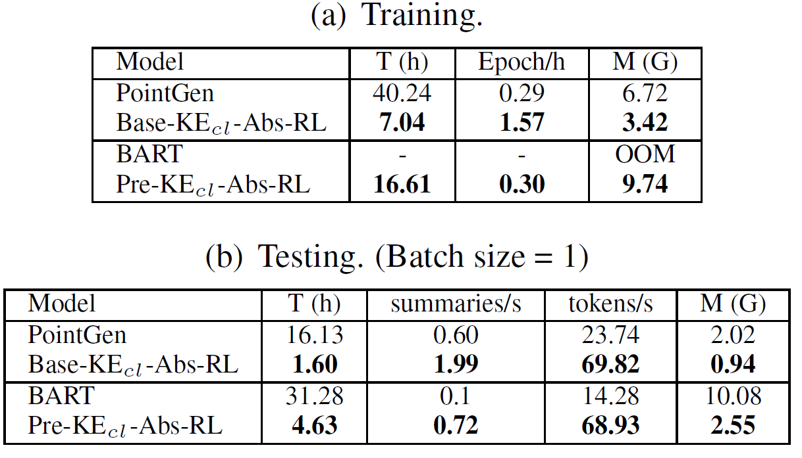
Evaluation
Speed and memory usage

Slide 66
To Sum Up My Talk ..
Text generation is a hard NLP problem
To enable machine to speak/write/interact like human is the ultimate goal of AI
Some of the techniques we developed can be applied in certain limited scenarios but are not completely generalized
Evaluation is a big challenge for text generation
There’s still a lot of work to be done!

Slide 67
Questions?

